Slide 1
Multiplication and division where only one value is negative
Arithmetic procedures with integers and decimals

Slide 2
how to use Oak lessons

Slide 3
I can use the mathematical structures that underpin multiplication and division of one or more positive integers with one negative integer.

Slide 4
The dividend is what we are dividing.
The divisor is what we are dividing by.

Slide 5

Multiplication and division where only one value is negative
Multiplying when only one value is negative
Dividing when the dividend is negative

Slide 6
Multiplying when only one value is negative
Jun & Laura each have 24 negative counters.
Jun sets his out like this:
4 groups of (−6) = (−24)
4 ‘lots of’ (−6) = (−24)
4 × (−6) = (−24)
−
−
−
−
−
−
−
−
−
−
−
−
−
−
−
−
−
−
−
−
−
−
−
−
(−6) | (−6) | (−6) | (−6)
Laura sets hers out like this:
6 groups of (−4) = (−24)
6 ‘lots of’ (−4) = (−24)
6 × (−4) = (−24)
−
−
−
−
−
−
−
−
−
−
−
−
−
−
−
−
−
−
−
−
−
−
−
−
(−4) | (−4) | (−4) | (−4) | (−4) | (−4)

Slide 7
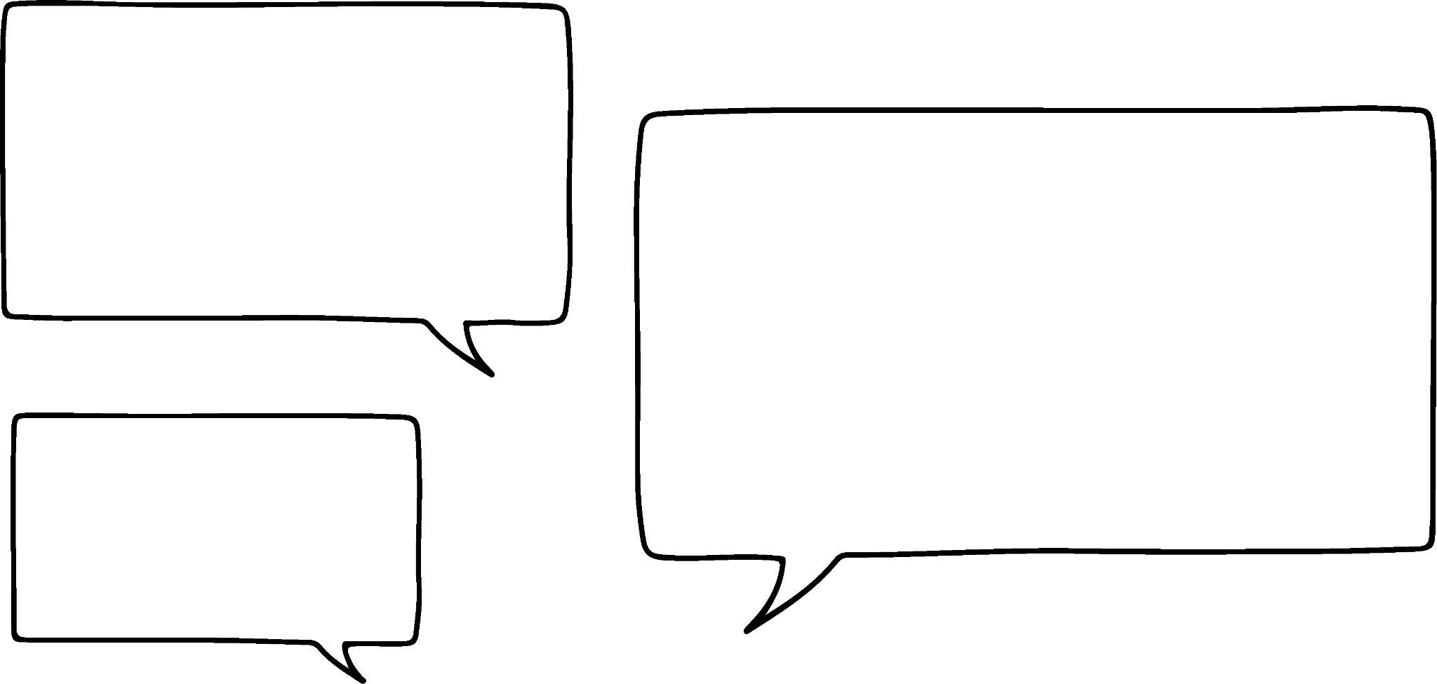


Multiplying when only one value is negative
−
−
−
−
−
−
−
−
−
−
−
−
I can see three groups of negative four.
I can see four groups of negative three.
Who is right?
They are both right.

Slide 8
Multiplying when only one value is negative
Write two number sentences to describe this array.
−
−
−
−
−
−
−
−
−
−
−
−
−
−
−
−
−
−
−
−
−
−
−
−
−
−
−
−
−
−
−
−
Eight groups of negative four.
Four groups of negative eight.

Slide 9
Multiplying when only one value is negative
It doesn’t matter which way you interpret the array.
−
−
−
−
−
−
−
−
−
−
−
−
−
−
−
−
−
−
−
−
4 × (−5) = (−20)
5 × (−4) = (−20)

Slide 10

Multiplying when only one value is negative
Identify all of the alternative ways of writing 6 × (−3)
3 × (−6)
(−3) × (−6)
(−3) × 6
(−6) × 3

Slide 11
Multiplying when only one value is negative
Calculate the answers to the following questions:
(−3) × 5
8 × (−4)
(−9) × 8
5 × (−12)
(−15) × 5
(−565) × 2
9 × (−65)

Slide 12
Multiplying when only one value is negative
2) Write down as many products as you can with the following answers.
(−60)
(−18)
(−72)
(−100)
(−250)
(−165)

Slide 13
Multiplying when only one value is negative
3)
Decode the word. Find the answers in the grid and rearrange the letters to make a word.
A | B | C | D | E | F | G | H | I | J | K | L | M
−162 | −154 | −255 | −85 | −180 | −310 | −165 | −454 | −336 | −186 | −458 | −175 | −360
N | O | P | Q | R | S | T | U | V | W | X | Y | Z
−135 | −570 | −654 | −820 | −465 | −278 | −126 | −78 | −528 | −369 | −860 | −100 | −582
(−36) × 5
14 × (−9)
(−8) × 66
(−55) × 3
e) 6 × (−27)
f) (−27) × 5
g) 45 × (−4)
h) (−56) × 6
i) Write your own word using the code.

Slide 14
Multiplying when only one value is negative
Calculate the answers to the following questions:
(−3) × 5 = (−15)
8 × (−4) = (−32)
(−9) × 8 = (−72)
5 × (−12) = (−60)
(−15) × 5 = (−75)
(−565) × 2 = (−1130)
9 × (−65) = (−585)

Slide 15
Multiplying when only one value is negative
2) Write down as many products as you can with the following answers.
(−60) e.g. (−6) × 10, 12 × (−5), (−1) × 60
(−18) e.g. (−6) × 3, 2 × (−9), (−2) × 9
(−72) e.g. (−6) × 12, 36 × (−2), (−9) × 8
(−100) e.g. (−10) × 10, 25 × (−4), (−20) × 5
(−250) e.g. (−10) × 25, 2 × (−125), (−50) × 5
(−165) e.g. (−5) × 33, 11 × (−15), (−165) × 1

Slide 16
Multiplying when only one value is negative
3)
Decode the word. Find the answers in the grid and rearrange the letters to make a word.
A | B | C | D | E | F | G | H | I | J | K | L | M
−162 | −154 | −255 | −85 | −180 | −310 | −165 | −454 | −336 | −186 | −458 | −175 | −360
N | O | P | Q | R | S | T | U | V | W | X | Y | Z
−135 | −570 | −654 | −820 | −465 | −278 | −126 | −78 | −528 | −369 | −860 | −100 | −582
(−36) × 5 = (−180)
14 × (−9) = (−126)
(−8) × 66 = (−528)
(−55) × 3 = (−165)
e) 6 × (−27) = (−162)
f) (−27) × 5 = (−135)
g) 45 × (−4) = (−180)
h) (−56) × 6 = (−336)
i) Write your own word using the code.
The word is negative

Slide 17
Multiplication and division where only one value is negative
Multiplying when only one value is negative
Dividing when the dividend is negative

Slide 18
Dividing when the dividend is negative
(−24) ÷ 4
= (−6)
(−24) shared into 4 groups
(−24)
−
−
−
−
−
−
−
−
−
−
−
−
−
−
−
−
(−6)
(−6)
(−6)
(−6)
−
−
−
−
−
−
−
−
−
−
−
−
−
−
−
−
−
−
−
−
−
−
−
−
−
−
−
−
−
−
−
−

Slide 19
Dividing when the dividend is negative
We now know that:
(−24) ÷ 4 = (−6)
Yes is it does.
If (−24) ÷ 4 = (−6), then (−24) ÷ 6 = (−4).
Does that mean that negative 24 divided by 6 is negative four?

Slide 20
Dividing when the dividend is negative
(−12) ÷ 3
= (−4)
(−12) shared into 3 groups
(−12)
−
−
−
−
−
−
−
−
−
−
−
−
(−4)
(−4)
(−4)
−
−
−
−
−
−
−
−
−
−
−
−
What other fact do we know from this?
(−12) ÷ 4 = (−3)

Slide 21
Dividing when the dividend is negative
Which one of the following is the odd one out? (It has a different answer to the others)
(−32) ÷ 8
(−16) ÷ 4
(−25) ÷ 5
(−28) ÷ 7

Slide 22
Dividing when the dividend is negative
Calculate the answers to the following questions:
(−20) ÷ 5
(−72) ÷ 9
(−96) ÷ 12
(−88) ÷ 11
(−42) ÷ 6
(−850) ÷ 10
(−325) ÷ 5
(−1376) ÷ 8

Slide 23
Dividing when the dividend is negative
2) Write down as many division questions as you can with the following answers.
(−4)
(−12)
(−10)
(−24)
(−50)
(−376)

Slide 24
Dividing when the dividend is negative
3)
Answer the questions, shade the answers in the grid to reveal something.
(−36) ÷ 6
(−81) ÷ 9
(−42) ÷ 6
(−36) ÷ 3
(−66) ÷ 6
(−150) ÷ 75
(−96) ÷ 12
(−100) ÷ 5
(−300) ÷ 75
(−180) ÷ 12
(−1) | (−13) | (−3) | (−10) | (−13) | (−25) | (−5) | (−25) | (−1) | (−30)
(−5) | (−3) | (−13) | (−1) | (−12) | (−9) | (−13) | (−14) | (−3) | (−5)
(−25) | (−10) | (−5) | (−3) | (−2) | (−20) | (−5) | (−10) | (−5) | (−25)
(−13) | (−30) | (−25) | (−13) | (−30) | (−3) | (−14) | (−30) | (−13) | (−10)
(−10) | (−20) | (−6) | (−15) | (−11) | (−9) | (−4) | (−12) | (−8) | (−5)
(−30) | (−2) | (−7) | (−8) | (−9) | (−15) | (−7) | (−20) | (−11) | (−1)
(−5) | (−25) | (−3) | (−25) | (−1) | (−30) | (−5) | (−3) | (−5) | (−30)
(−13) | (−1) | (−5) | (−3) | (−4) | (−6) | (−5) | (−30) | (−13) | (−1)
(−10) | (−5) | (−1) | (−10) | (−8) | (−11) | (−25) | (−10) | (−25) | (−5)
(−3) | (−25) | (−13) | (−30) | (−5) | (−1) | (−30) | (−5) | (−10) | (−3)

Slide 25
Dividing when the dividend is negative
Calculate the answers to the following questions:
(−20) ÷ 5 = (−4)
(−72) ÷ 9 = (−8)
(−96) ÷ 12 = (−8)
(−88) ÷ 11 = (−8)
(−42) ÷ 6 = (−7)
(−850) ÷ 10 = (−85)
(−325) ÷ 5 = (−65)
(−1376) ÷ 8 = (−172)

Slide 26
Dividing when the dividend is negative
2) Write down as many division questions as you can with the following answers.
(−4) e.g. (−16) ÷ 4, (−24) ÷ 6
(−12) e.g. (−60) ÷ 5, (−24) ÷ 2
(−10) e.g. (−60) ÷ 6, (−240) ÷ 24
(−24) e.g. (−48) ÷ 2, (−120) ÷ 5
(−50) e.g. (−250) ÷ 5, (−800) ÷ 16
(−376) e.g. (−1128) ÷ 3, (−3008) ÷ 8

Slide 27
Dividing when the dividend is negative
3)
Answer the questions, shade the answers in the grid to reveal something.
(−1) | (−13) | (−3) | (−10) | (−13) | (−25) | (−5) | (−25) | (−1) | (−30)
(−5) | (−3) | (−13) | (−1) | (−12) | (−9) | (−13) | (−14) | (−3) | (−5)
(−25) | (−10) | (−5) | (−3) | (−2) | (−20) | (−5) | (−10) | (−5) | (−25)
(−13) | (−30) | (−25) | (−13) | (−30) | (−3) | (−14) | (−30) | (−13) | (−10)
(−10) | (−20) | (−6) | (−15) | (−11) | (−9) | (−4) | (−12) | (−8) | (−5)
(−30) | (−2) | (−7) | (−8) | (−9) | (−15) | (−7) | (−20) | (−11) | (−1)
(−5) | (−25) | (−3) | (−25) | (−1) | (−30) | (−5) | (−3) | (−5) | (−30)
(−13) | (−1) | (−5) | (−3) | (−4) | (−6) | (−5) | (−30) | (−13) | (−1)
(−10) | (−5) | (−1) | (−10) | (−8) | (−11) | (−25) | (−10) | (−25) | (−5)
(−3) | (−25) | (−13) | (−30) | (−5) | (−1) | (−30) | (−5) | (−10) | (−3)
(−6)
(−9)
(−7)
(−12)
(−11)
(−2)
(−8)
(−20)
(−4)
(−15)

Slide 28

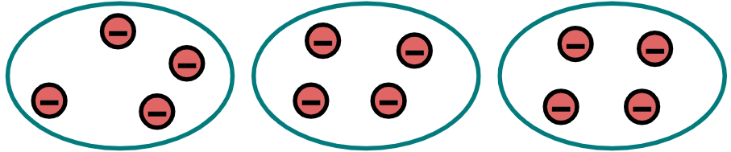
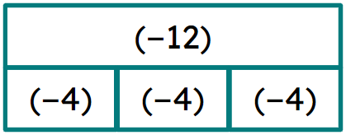
Multiplication and division where only one value is negative
Negative counters can be used to help with multiplication of a positive and negative integer. E.g. 2 × (−3) = (−6)
Negative counters and bar models can be used to help with division of a negative integer by a positive integer.
E.g. (−12) ÷ 3 = (−4)

Slide 29

© Oak National Academy 2023.
Produced in partnership with Mathematics in Education and Industry.
Licensed on the Open Government Licence v3.0, except where otherwise stated. See Oak terms and conditions.

